Slide 1
Inquiry

Slide 2
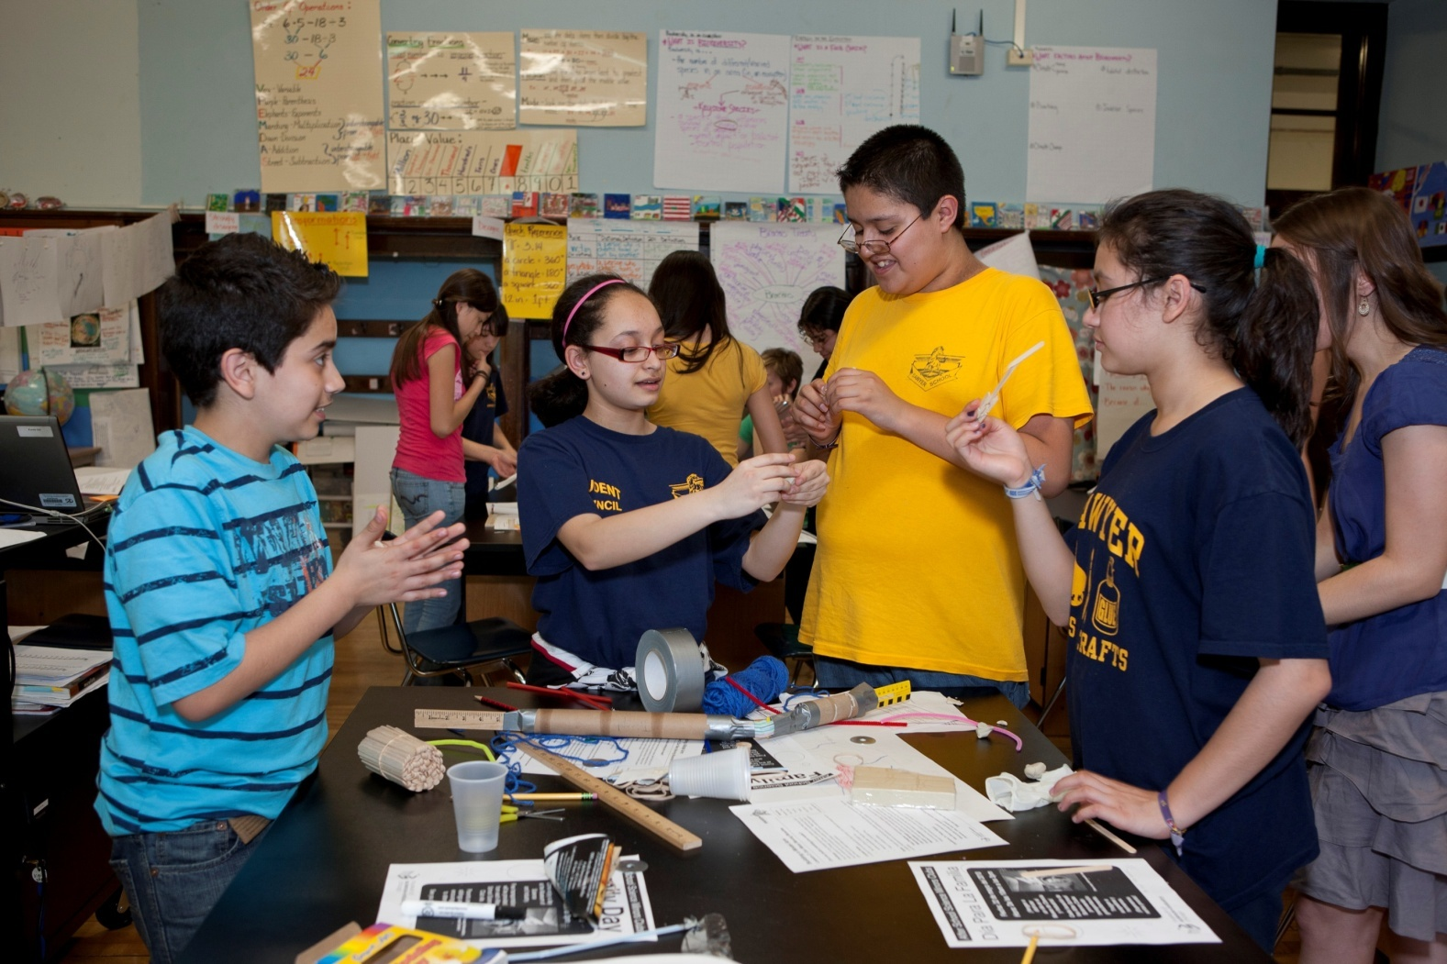
Hands-On Learning
Notes:
Students in a hands-on science program will remember the material better, feel a sense of accomplishment when the task is completed, and be able to transfer that experience easier to other learning situations. When more than one method of learning is accessed as in hands-on learning, the information has a better chance of being stored in the memory for useful retrieval. Students who have difficulty in the learning arena for reasons of ESL barriers, auditory deficiencies, or behavioral interference can be found to be on task more often because they are part of the learning.

Slide 3
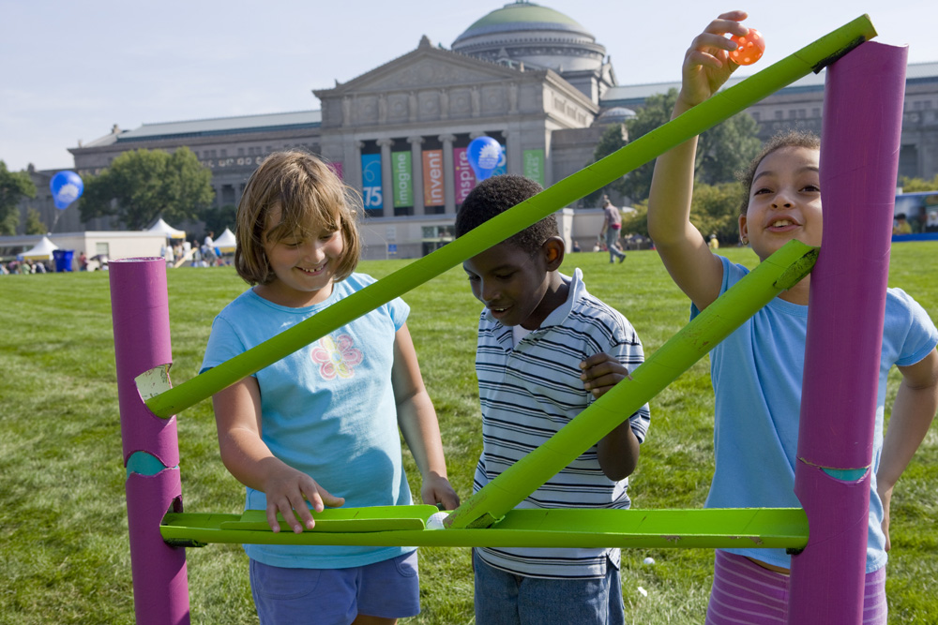
Inquiry
increased student involvement
development of reasoning and procedural skills
engagement of students’ multiple intelligences
understanding the nature of scientific work
Notes:
Inquiry is, at a minimum allowing students to conceptualize a problem that was solved by a scientific discovery, and
then forcing them to wrestle with possible answers to the problem before they are told the answer.
increased student involvement,
- By using student derived investigations knowledge is more relevant and meaningful, and reaches a higher level of cognition
- transforms learning from watching and listening to doing
(2) Development of reasoning and procedural skills
- designing procedures to find an answer to a question (what is an interesting question? What is an appropriate way to explore that question?)
- using/choosing tools to gather, analyze, and interpret data
- Constructing meaning through the use of logic and evidence [active construction of meaningful knowledge, rather than passive acquisition of facts transmitted from a lecture
(3) Engagement of students’ multiple intelligences
- more types of students are successful contributors and students are engaged on more than one level.
(4) Understanding the nature of scientific work
- the student to student collaboration reinforces assimilation of knowledge
- while the teacher to student collaboration builds trust for future discovery.
- students to acquire some of the reasoning and procedural skills of scientists
- a clear understanding of the nature of science as a distinct type of human endeavor.

Slide 4
Level | Type of Inquiry | Description
0 | Confirmation/Verification | Students confirm a principle through a prescribed activity when the results are known in advance.
1 | Structured Inquiry | Students investigate a teacher-presented question through a prescribed procedure.
2 | Guided Inquiry | Students investigate a teacher-presented question using student designed/ selected procedures.
3 | Open Inquiry | Students investigate topic-related questions that are student formulated through student designed/ selected procedures.
Notes:
0 - cookbook type lesson- the directions are written out and you know what the result is (hopefully) going to be
1 - Structured Inquiry Teacher models and guides as students are provided an investigation opportunity. Teacher guides reasoning through discussion.
2 - Guided Inquiry Teacher presents the question, but let the students determine how they are going to conduct their investigation. Students focus on all aspects of the investigation while teacher guides the connections
3 - Open Inquiry, it is all student driven: students generate questions from a topic selected by the teacher and design their own investigaton. Teacher guides reasoning only if necessary as students solve problems.
Where on this scale do you think Fresh vs. Salt would fit in?

Slide 5
Hands-On
No Full
Inquiry Inquiry
Hands-Off
e.g. step-by-step teacher-directed activity
e.g. self-directed Science Fair project
e.g. read book chapter and answer questions
e.g. self-directed internet research

Slide 6
Inquiry Wheel
Independent Variables (manipulated or
“I Control”) are on the inside of the circle.
Dependent Variables (responding) are on the outside of the circle.
How does the …
independent
Affect the …
dependent

Slide 7
Bloom’s Taxonomy
Arranged in order of complexity
Use the key words when writing objectives and during check for understanding
Helps students stretch their knowledge and understanding to higher levels.
Knowledge
Evaluation

Slide 8
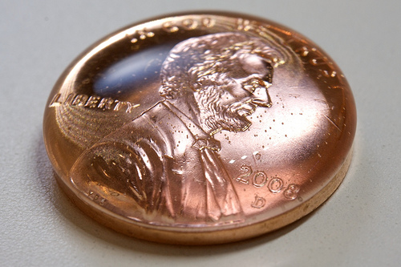
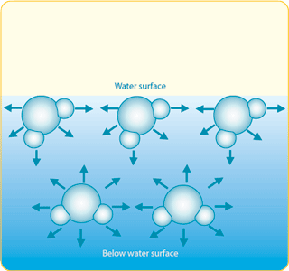
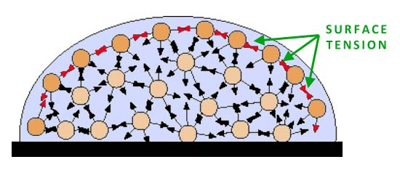
Surface Tension
Notes:
The water molecules on the surface have partners for hydrogen bonding only within the liquid; above the water surface there are no more molecules available for hydrogen bonding. This means that molecules at the surface experience a net force pulling them inward. If you fill a glass right up to the rim and then carefully add a few more drops of water, you can see that the glass can be overfilled without spilling. The surface tension of the water holds on to the 'extra' water as if there were a skin on the surface of the water.
Picture a glass full of water, and the water molecules within that glass. Constantly pulling towards each other and forming hydrogen bonds, these molecules experience cohesion, a force that attracts the molecules to one another and pulls them together. This attracting force is, as explained above, is a result of the polar distribution of the molecule’s electrical charges. This attraction is most evident when looking at the surface of water: if we fill the water glass to the brim and gently add more water, the level of the water will rise over the rim of the glass without spilling. The cohesive forces between water molecules causes the water surface to behave as a type of skin, holding the water in and acting against the pull of gravity. This ability to resist an external force is called surface tension, and it is the reason why water forms drops, piles up above a glass’ rim, and allows certain insects to skate upon its surface.

Slide 9
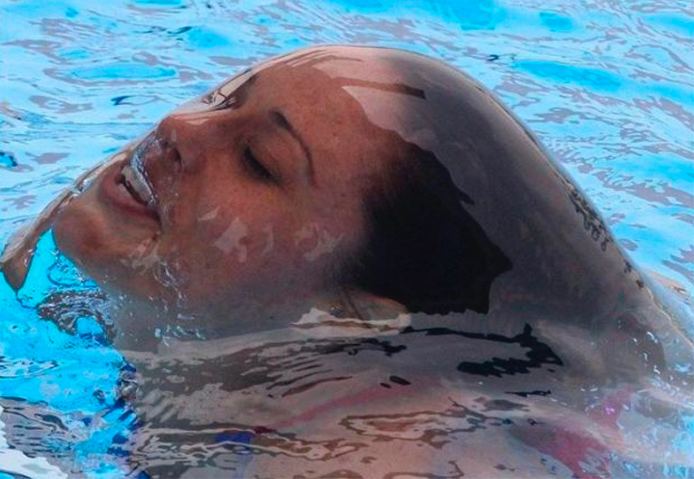
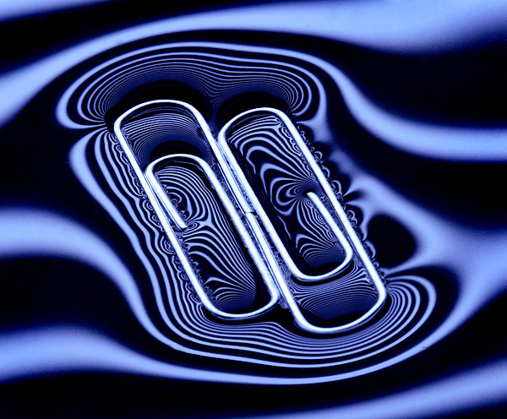
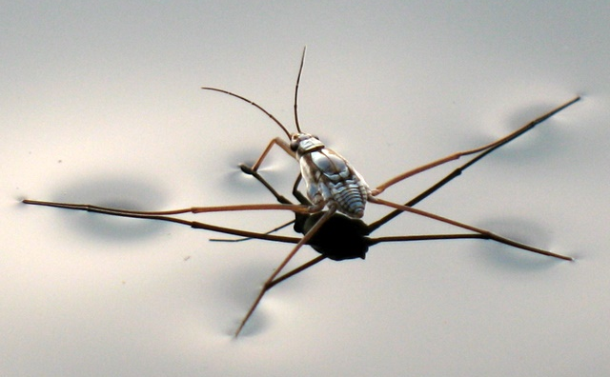
Notes:
Picture a glass full of water, and the water molecules within that glass. Constantly pulling towards each other and forming hydrogen bonds, these molecules experience cohesion, a force that attracts the molecules to one another and pulls them together. This attracting force is, as explained above, is a result of the polar distribution of the molecule’s electrical charges. This attraction is most evident when looking at the surface of water: if we fill the water glass to the brim and gently add more water, the level of the water will rise over the rim of the glass without spilling. The cohesive forces between water molecules causes the water surface to behave as a type of skin, holding the water in and acting against the pull of gravity. This ability to resist an external force is called surface tension, and it is the reason why water forms drops, piles up above a glass’ rim, and allows certain insects to skate upon its surface.
http://www.youtube.com/watch?v=Spc9r4CHRDo&feature=related

Slide 10
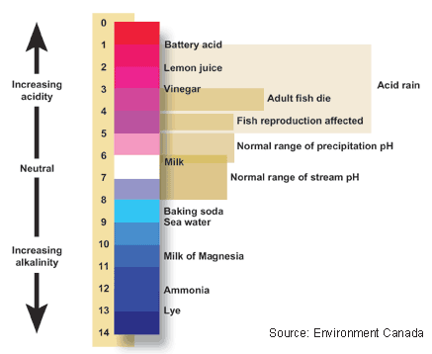
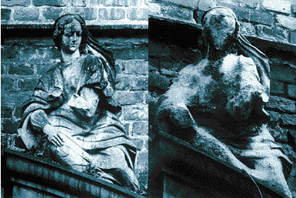
Water acidity increases solubility
1908
1968
Notes:
The pH of water determines the solubility and availability of chemicals in water, and can be a key factor in determining whether water is a healthy or unhealthy environment for living organisms.
The pH of water can make it so that certain nutrients are available for organisms to use
can also make it so that toxic heavy metals are dissolved and easily absorbed by organisms
extremely high pH can harm living tissues
The pH of water determines the solubility (amount that can be dissolved in the water) and biological availability (amount that can be utilized by aquatic life) of chemical constituents such as nutrients phosphorus, nitrogen, and carbon) and heavy metals (lead, copper, cadmium, etc.). For example, in addition to affecting how much and what form of phosphorus is most abundant in the water, pH may also determine whether aquatic life can use it. In the case of heavy metals, the degree to which they are soluble determines their toxicity. Metals tend to be more toxic at lower pH because they are more soluble

Slide 11
Inquiry Wheel
Independent Variables (manipulated or
“I Control”) are on the inside of the circle.
Dependent Variables (responding) are on the outside of the circle.
How does the …
independent
Shape
Shape
Shape
Shape
Affect the …
dependent
Notes:
Independent Variables Dependent Variables
How does the… Affect the…
Temperature Surface tension
Type of coin Surface tension
pH of the solution Absorbency
Type of paper towel Adhesion/ cohesion

Slide 12
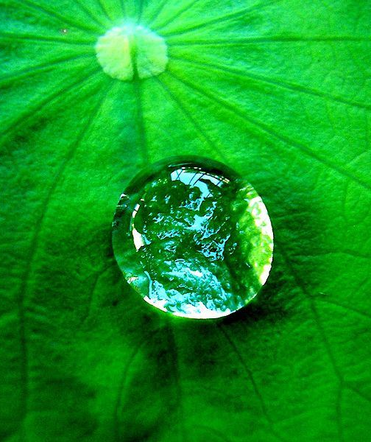
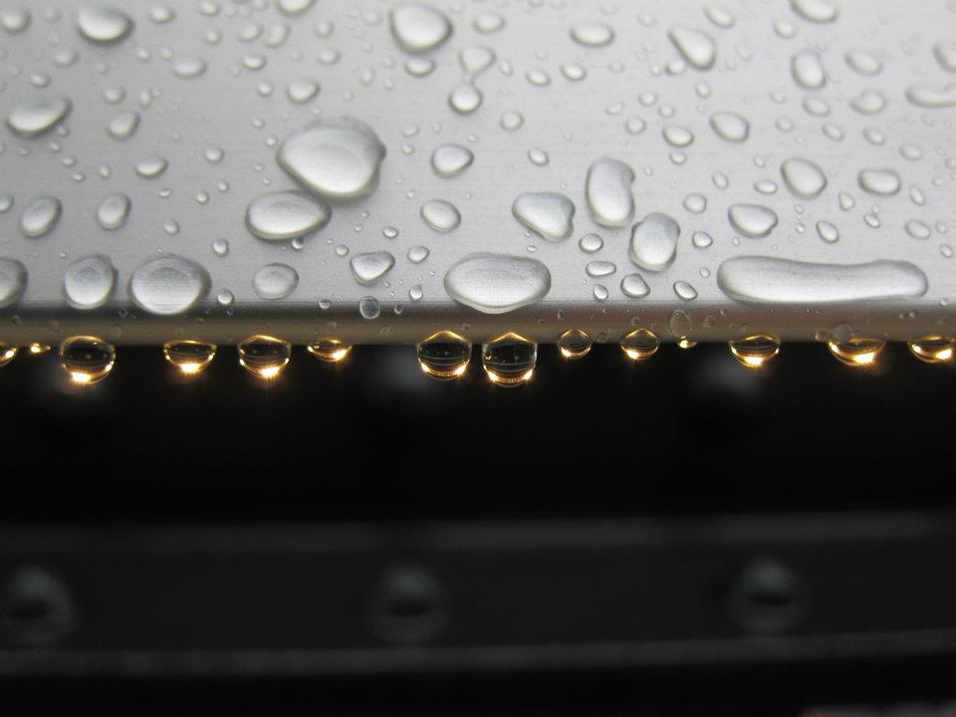
Part/Station 2: Cohesion & Adhesion
Cohesion: water molecules like to stick to each other
Adhesion: water molecules like to stick to other things
Notes:
Cohesion: water molecules like to stick to each other
Adhesion: water molecules like to stick to other things
When the paper towels are dipped in water, some of the water sticks to the paper towel and gets it wet. This happens because of adhesion, an attractive force between the water molecules and the molecules in the paper towel. Because of the force of cohesion, the water also sticks to itself. Both of these sticky forces - adhesion and cohesion - cause the water to travel up the paper towel, moving against gravity.
Why does the water eventually stop climbing the towel?

Slide 13
Designing A Scientific Investigation
What is the research question we are trying to answer?
What do we know that is related to this question (prior knowledge?)
How should we go about answering this question?
What are the results of our investigation?
Do the results reflect good scientific practice and are they relevant?
What conclusions can we draw?
Can we now answer the research question that drove our investigation?

Slide 14
Questions? Email us.
Patricia.Messersmith@msichicago.org
Pam.Barry@msichicago.org

